Slide 1
Data Vault DataWarehouse Architecture
Jeff Renz

Slide 2


Bio - Jeff Renz
Senior Consultant Statera
14 years SQL Server and BI
10 years Data Warehouse Design and Implementation
email jeff.renz@statera.com
Twitter @jeff_renz

Slide 3

Agenda
Enterprise Data Warehouse Architecture
Data Vault NFL Example
Data Vault Definitions
Solar Company Case Study
College Invest Solution
Q&A

Slide 4
Enterprise Data Warehouse
Provides a single data repository
Integrated data from more than one source
Facilitates reporting, analysis, performance management with a different focus for different departments and levels of management
Data auditing and historical storage

Slide 5
Data Models
3rd Normal Form is optimal for Operational Systems
Data Vault is optimal for Data Warehouse
Star Schema is optimal for OLAP Delivery/Data Marts
*** These models are independent of database platform

Slide 6
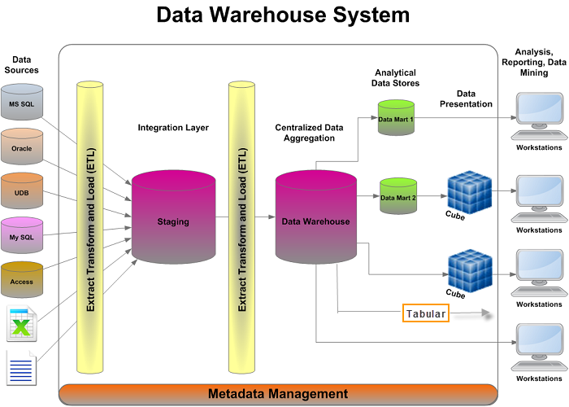
Enterprise Data

Slide 7
Data Mart
A data mart is the access layer of the data warehouse environment that is used to get data out to the users.
The data mart is a subset of the data warehouse which is usually oriented to a specific business line or team.

Slide 8
Dimensional Model
Concepts
FACT– contains business facts or measures and foreign keys which refer to candidate keys in the dimension tables.
Dimension- contain descriptive attributes (or fields). These attributes are designed to serve two critical purposes: query constraining/filtering and query result set labeling.

Slide 9
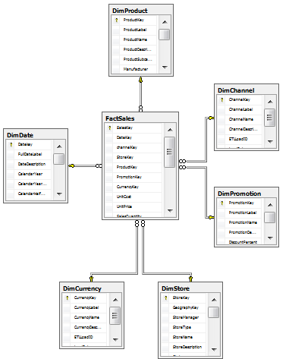
Star Schema

Slide 10
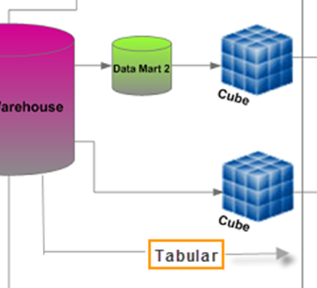
BI Semantic Model (BISM)
Multidimensional modeling - traditional online analytical processing (OLAP).
Tabular modeling provides self-service data modeling capabilities to business and data analysts

Slide 11
Data Vault
The Data Vault is a detail oriented, historical tracking and uniquely linked set of normalized tables that support one or more functional areas of business.
The design is flexible, scalable, consistent and adaptable to the needs of the enterprise.

Slide 12
Food For Thought
“Data Vault is all about the back-room, efficiently collecting, integrating and preserving data from the source systems.”
“Dimensional modeling is all about the front-room, publishing the organization’s data assets to effectively support decision making. “
  Marco Schreuder

Slide 13
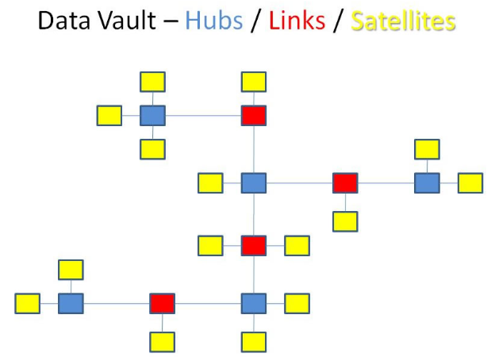
Data Vault Objects
Hubs – Business keys
Links - Relationships
Satellites – Descriptive information

Slide 14
Object Relationships
Records a history of the interaction
Customer
Product
Sat
Sat
Sat
Elements:
Hub
Link
Satellite
Link
Sat
Hub
F(x)
Hub
Sat
Sat
F(x)
F(x)
Sat
Sat
Hub
Sat
F(x)
Sat
Image from LearnDataVault.com; Dan Linstedt
Order

Slide 15
NFL Database Example
Data Source: Azure data market

Slide 16
Data Vault Concepts

Slide 17
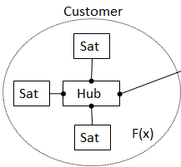
Hub
A hub is based on an identifiable business element
An identifiable business element is an attribute that is used in the source systems to locate data, otherwise known as a business primary key
The business primary key has a very low propensity to change, and usually is not editable on the source systems

Slide 18
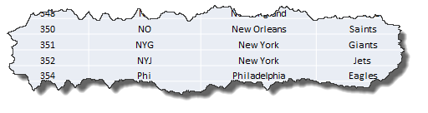
Example Finding the Business Key
TEAM_ID | TEAM_ABBREV | TEAM_NAME | TEAM_NICKNAME
323 | Atl | Atlanta | Falcons
324 | Buf | Buffalo | Bills
325 | Hou | Houston | Texans
326 | Chi | Chicago | Bears
327 | Cin | Cincinnati | Bengals
329 | Cle | Cleveland | Browns
331 | Dal | Dallas | Cowboys
332 | Den | Denver | Broncos
334 | Det | Detroit | Lions
335 | GB | Green Bay | Packers
336 | Ten | Tennessee | Titans
338 | Ind | Indianapolis | Colts
339 | KC | Kansas City | Chiefs
341 | Oak | Oakland | Raiders
343 | StL | St. Louis | Rams
345 | Mia | Miami | Dolphins
347 | Min | Minnesota | Vikings
348 | NE | New England | Patriots
350 | NO | New Orleans | Saints
351 | NYG | New York | Giants
352 | NYJ | New York | Jets
354 | Phi | Philadelphia | Eagles
355 | Ari | Arizona | Cardinals
356 | Pit | Pittsburgh | Steelers
357 | SD | San Diego | Chargers
359 | SF | San Francisco | 49ers
361 | Sea | Seattle | Seahawks
362 | TB | Tampa Bay | Buccaneers
363 | Was | Washington | Redskins
364 | Car | Carolina | Panthers
365 | Jac | Jacksonville | Jaguars
366 | Bal | Baltimore | Ravens

Slide 19
HUB Example
TeamSQN | TeamNickName | LDTS | RS
1 | Falcons | 1/14/13 9:18 PM | STATS Sports Database
2 | Bills | 1/14/13 9:18 PM | STATS Sports Database
3 | Texans | 1/14/13 9:18 PM | STATS Sports Database
4 | Bears | 1/14/13 9:18 PM | STATS Sports Database
5 | Bengals | 1/14/13 9:18 PM | STATS Sports Database
6 | Browns | 1/14/13 9:18 PM | STATS Sports Database
7 | Cowboys | 1/14/13 9:18 PM | STATS Sports Database
8 | Broncos | 1/14/13 9:18 PM | STATS Sports Database
Sequence Number, Business Key, Load Date, Record Source are mandatory
All attributes in the business key are a UNIQUE Index
NEVER directly join a HUB to another HUB table

Slide 20
Link
A Link is an association of two or more business keys
It is based on an identifiable business element relationships
It can contain Hub keys and other Link keys
A Link’s business key is a composite unique index

Slide 21
Link Example
TEAM_GAME
SEASON
TEAM (Opponent)
TEAM
HUB
Sequence Number, Business Key, Load Date, Record Source are mandatory
The relationship shouldn’t change over time. It is established as a fact that occurred at a specific point in time and will remain that way forever
LNK
HUB
HUB
TeamGameSQN | GameDate | SeasonSQN | TeamSQN | OpponentSQN | LDTS | RS
1 | 9/27/2012 | 33 | 6 | 32 | 1/15/13 7:11 PM | STATS Sports Database
2 | 9/27/2012 | 33 | 32 | 6 | 1/15/13 7:11 PM | STATS Sports Database
3 | 9/30/2012 | 33 | 2 | 18 | 1/15/13 7:11 PM | STATS Sports Database
4 | 9/30/2012 | 33 | 18 | 2 | 1/15/13 7:11 PM | STATS Sports Database
5 | 9/30/2012 | 33 | 3 | 11 | 1/15/13 7:11 PM | STATS Sports Database
6 | 9/30/2012 | 33 | 11 | 3 | 1/15/13 7:11 PM | STATS Sports Database
7 | 9/30/2012 | 33 | 13 | 25 | 1/15/13 7:11 PM | STATS Sports Database
8 | 9/30/2012 | 33 | 25 | 13 | 1/15/13 7:11 PM | STATS Sports Database

Slide 22
Satellite
A Satellite is based on a non-identifying business elements
“Descriptive data”
Satellite data changes, sometimes rapidly, sometimes slowly
Satellites are separated by type of information and rate of change

Slide 23
SAT Example
TeamSQN | LDTS | STATSTeamID | TeamAbbrev | TeamName | LEDTS | RS
1 | 1/14/13 9:24 PM | 323 | Atl | Atlanta | NULL | STATS Sports Database
2 | 1/14/13 9:24 PM | 324 | Buf | Buffalo | NULL | STATS Sports Database
3 | 1/14/13 9:24 PM | 325 | Hou | Houston | NULL | STATS Sports Database
4 | 1/14/13 9:24 PM | 326 | Chi | Chicago | NULL | STATS Sports Database
5 | 1/14/13 9:24 PM | 327 | Cin | Cincinnati | NULL | STATS Sports Database
6 | 1/14/13 9:24 PM | 329 | Cle | Cleveland | NULL | STATS Sports Database
7 | 1/14/13 9:24 PM | 331 | Dal | Dallas | NULL | STATS Sports Database
8 | 1/14/13 9:24 PM | 332 | Den | Donkeys | 1/16/13 8:35 PM | Upset Fan
8 | 1/16/13 8:35 PM | 332 | Den | Denver | NULL | STATS Sports Database
Satellite is dependent on the Hub or Link key as a parent
The Satellite is never dependent on more than one parent table
The Satellite is not a parent table to any other table
Sequence Number, Business Key, Load Date, Load End Date, Descriptive Data and Record Source are mandatory

Slide 24
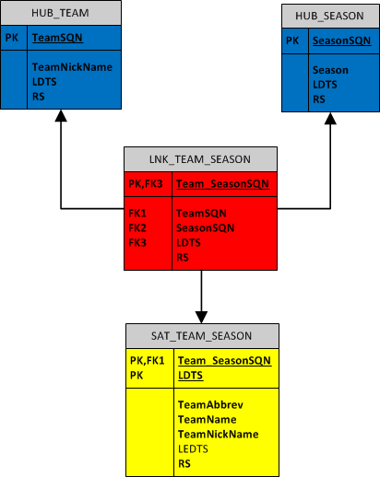
Unit of Work
Defines an associated set of data
Functions to keep multiple associations intact
Provides a functional module for queries on link data
Breaking a Unit of Work apart will cause associations between source system entities to be lost

Slide 25
Data Vault
Pros
Better real time load capabilities - Mostly inserts
Incremental builds = Easy
Provides Audit History and traceability
The ability to respond to changes rapidly in your physical model
Iterative development
Keeping control of and reporting on data quality issues

Slide 26
Data Vault
Cons
It is suggested that the extra joins introduced with Data Vault modeling will impact query performance
  Depends on size, hardware, database and indexing strategy.
  Queries to populate Dimensional models will only apply to new and changed rows
Adhoc reporting
  Use views
Two data warehouses - twice the cost ?

Slide 27
solar company case study

Slide 28
Data Vault Architecture Performance
Processing 4x the hits at almost 10 times the throughput with a third of the latency
The new data vault architecture are achieving these results with less CPU and memory
Metric | Legacy | New System
HITS PER SECOND | 5 | 23
THOUGHPUT | 5KBps | 48KBps
AVERAGE LATENCY | 99ms | 35ms
IOPs - AVERAGE | 97 per sec | 5 per sec
IOPs - SPIKES | 1500 per sec | 225 per sec
SERVER CPU | 869MHz | 537MHz
SEVER MEMORY | 12 GB | 8 GB

Slide 29
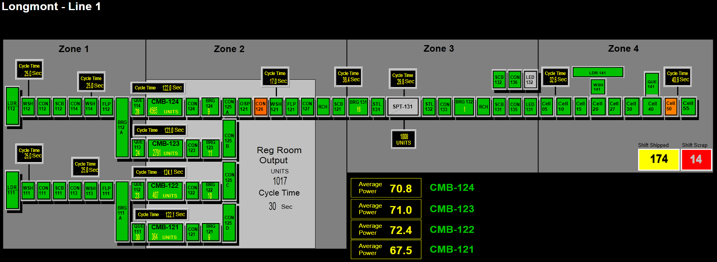
Solar Company Manufacturing Overview

Slide 30
Data Collection Challenge
Records Per Line | Daily | Annually
TOOL ALARMS | 500 | 180 MILLION
MODULE MEASURMENTS | 40000 | 14.6 BILLION
MODULE PRODUCTS | 2000 | 700 K
TOOL EXIT EVENTS | 60000 | 21.9 BILLION

Slide 31
Design Requirements
Business requirements
  Supports real time SPC
  Implement business logic which determines how to build product, and collect all the information generated from multiple 24x7 manufacturing lines
IT goals
  Scalable solution for next mega factory
  BI solution that supports a less than 5 minute ETL to a STAR Schema data mart
  Key reports run off of data mart OLAP cubes
  Interactive UI that allows managers to find answers quickly

Slide 32
Scale Up and Scale Out
Ability to add more CPU and memory that results in measureable performance improvement
Ability to add more servers that results in measureable performance improvements

Slide 33
Data Loading Requirements
Data loading order does not result in erroneous data according to business rules
Minimize data loading time (inserts vs. updates)
Quick close of transaction
No database down time for maintenance 24x7 manufacturing

Slide 34
Service Broker
Allowed queuing for alarm order (order counts)
Convenient way to send data across multiple databases in parallel
Pause receiver for maintenance or modifications

Slide 35
Conclusions
When you know the rules and how to apply them its easy to find that data
Really performs well under large amounts of parallel transactions
Never had locking issues including any contention between loading and ETL out
Business logic changes were applied quickly

Slide 36
College Invest Project

Slide 37
Links
http://blog.in2bi.eu/business-intelligence/dimensional-modeling-and-data-vault-ndash-a-happy-marriage/
http://GeneseeAcademy.com

Slide 38
Q&A

Slide 39
Backup Slides

Slide 40
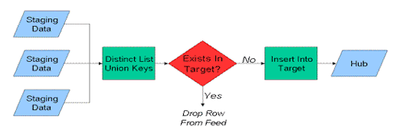
Hub Table Loading

Slide 41
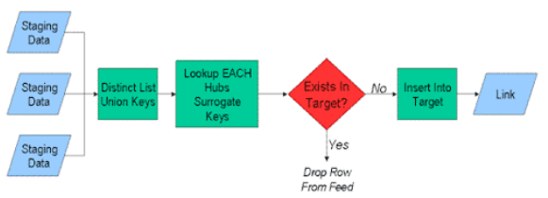
Link Table Loading

Slide 42
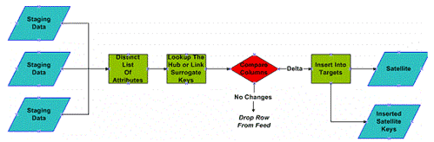
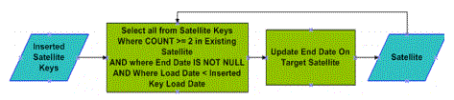
Sat Table Loading
Logic to update LEDTS

